Slide 1
Chapter 3
Data Modeling Using the Entity-Relationship (ER) Model

Slide 2
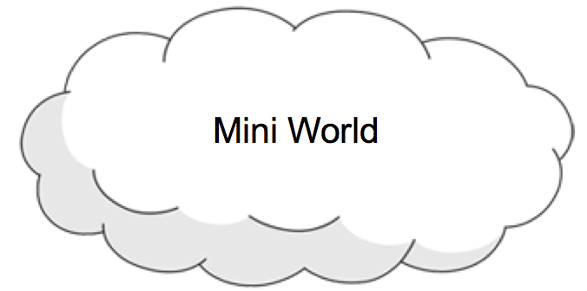




How to create a Database System
Application
DB
Database

Slide 3
Overview of Database Design Process
Two main activities:
Database design
design the conceptual schema for a database application
Applications design
Design interfaces and write programs that access the database and interact with the user using the interface.
Generally considered part of software engineering
Application
DB
Database

Slide 4

Three-Schema Architecture
Application programs
payroll
billing
records
View 1
View 2
View 3
External
Schemas
External/Conceptual
mapping
Conceptual schema
Conceptual/Internal
mapping
Internal schema
Database

Slide 5
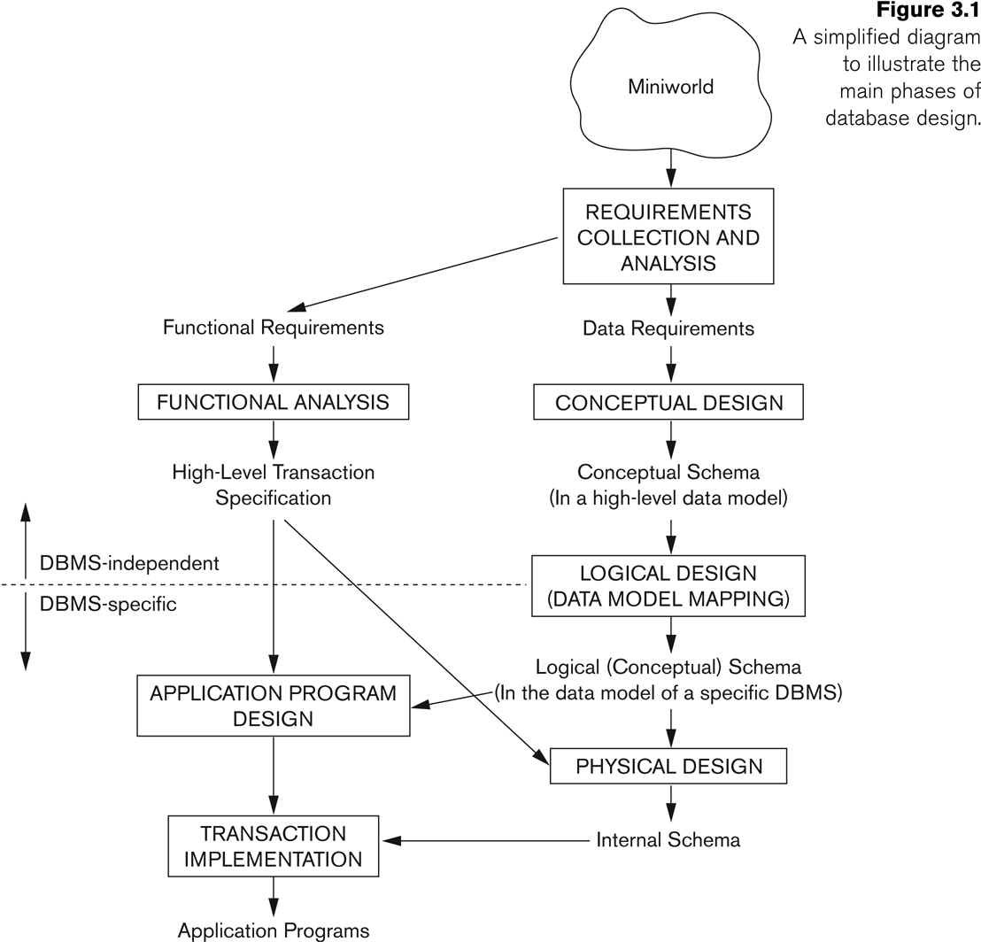

Overview of Database Design Process
Applications design
External schema
Conceptual schema
Internal schema
Database design
Notes:
Requirement collection and analysis
DB requirements and functional requirements
Conceptual DB design using a high-level model
Easier to understand and communicate with others
Logical DB design (data model mapping)
Conceptual schema is transformed from a high-level data model into implementation data model
Physical DB design
Internal data structures and file organizations for DB are specified
Schema Refinement: (Normalization)
Check relational schema for redundancies and anomalies.
Physical Database Design and Tuning:
Consider typical workloads and further refinement of the database design (v.g. build indices).
Application and Security Design:
Consider aspects of the application beyond data. Methodologies like UML often used for addressing the complete software development cycle.

Slide 6
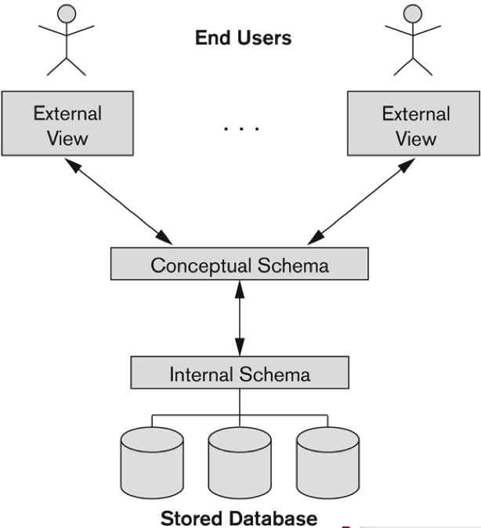
How to create a database
Create views for End Users
Create base relations with SQL DDL
base relations
Specify the storage structures

Slide 7
The Entity-Relationship Model
1976 proposed by Peter Chen
The ER model allows us to sketch database schema designs.
Includes some constraints, but not operations.
Designs are pictures called ER diagrams.
ER diagram is widely used in database design
Represent conceptual level of a database system
Describe things and their relationships in high level

Slide 8
Framework for ER
Design is a serious business.
The “boss” knows they want a database, but they don’t know what they want in it.
Sketching the key components is an efficient way to develop a working database.
Notes:
Compare a house design with database design.

Slide 9
Basic Concepts
Entity Sets
Relationship Sets
Design Issues
Mapping Constraints
Keys
ER Diagram
Extended ER Features
Design of an ER Database Schema
Reduction of an ER Schema to Tables

Slide 10
ER Model
Entity Sets
Regular Entity sets
Weak Entity sets
Relationship Sets
Binary 1:1 Relation sets
Binary 1:N Relationship sets.
Binary M:N Relationship sets.
N-ary Relationship sets.
Weak Relationship sets
Attributes
Entity Attributes
Relationship Attributes

Slide 11
Entity and Entity Set
Entity
A distinguishable object in the real world that need to be represented in the database.
Example: a specific person, company, event,
Entity Set
A set of entities that share the same properties.
Depicted as a rectangle.
Examples
Student
Set of students
Course
Set of courses
Instructor
Set of instructors

Slide 12
Attributes
Attribute
information that describes an entity
Example, a person has a name and birthdate
A specific entity will have a value for each of its attributes.
Example, a specific person has a name John and birthdate ‘09-Jan-1990’
Depicted as an oval, with a line to the rectangle representing its entity set.
Example
S#
Name
Age
Student

Slide 13
Kinds of Attributes
Simple
has an atomic value for the attribute.
Example:
Composite
composed of several components.
Example:
Multi-valued
may have multiple values for that attribute.
Example
Derived attributes:
Example
Name
First
Last
Name
Phone
GPA

Slide 14
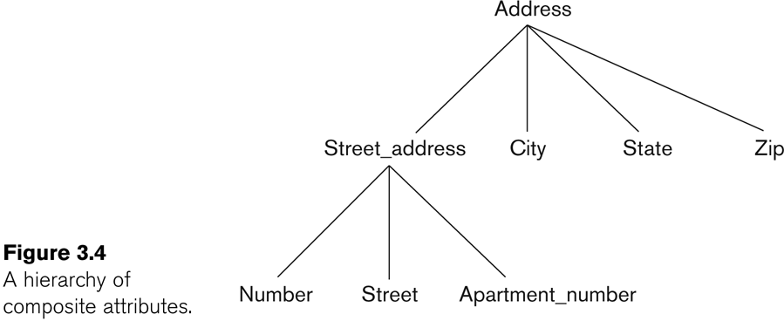
Example of a composite attribute

Slide 15
Kinds of Attributes
In general, composite and multi-valued attributes may be nested arbitrarily to any number of levels, although this is rare.
Professor
Degrees
College
Year
Degree
Field
Degrees of a professor is a composite multi-valued attribute as multiple degree values can exist
Each has four subcomponent attributes

Slide 16
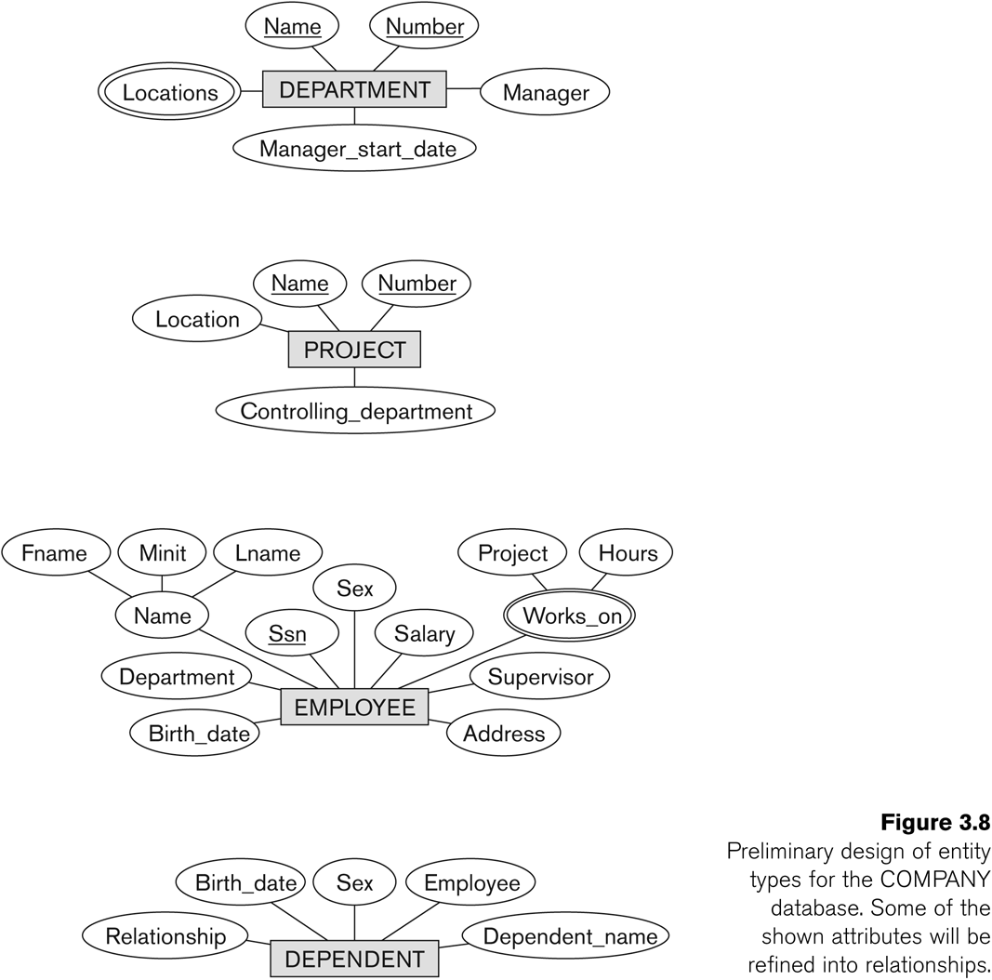
Entity Set Examples

Slide 17
Relationships and Relationship Sets
Relationship:
It relates two or more entities with a specific meaning
Example: John takes Database course.
Relationship Set:
A set of similar relationships on same entity sets
Depicted as a diamond, with lines to each of the entity sets involved.
Attributes on Relationships
Information that describes the relationship
Takes
Student
Course
Mark

Slide 18
ER Diagram Examples
Credit
Instructor
Teaches
Course
QTY
Supplier
Supplies
Part
Balance
Bank
Account
Customer

Slide 19
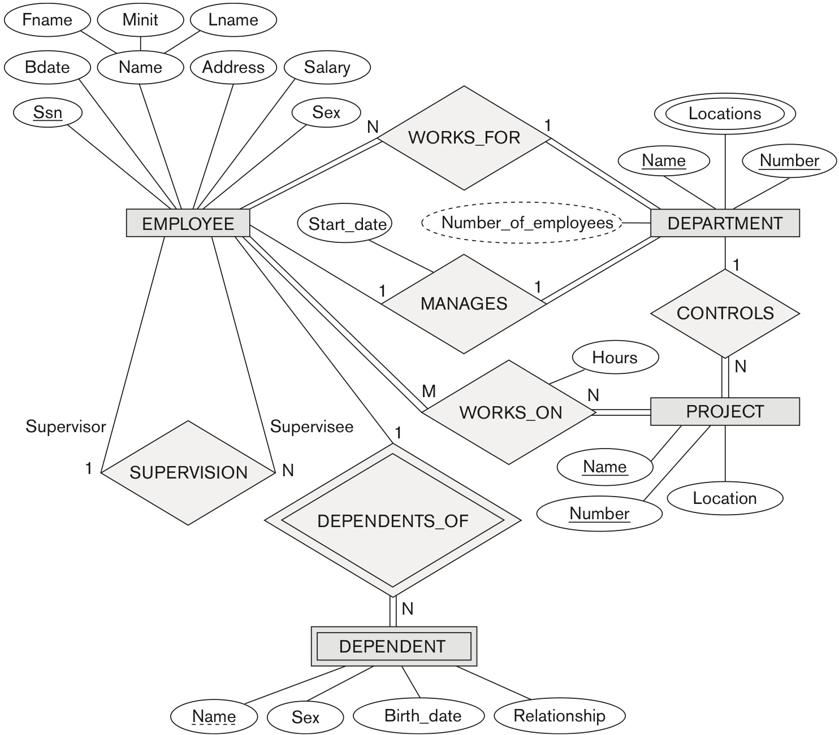
Company ER Diagram
Figure 3.2 An ER schema diagram for the COMPANY database.

Slide 20
Participation Constraints
Total participation
indicated by double line:
every entity in the entity set participates in at least one relationship in the relationship set
Partial participation:
indicated by single line:
some entities may not participate in any relationship in the relationship set
has
Dept
Employee

Slide 21
Key Attribute
An attribute of an entity set for which each entity must have a unique value.
We must designate a key for every entity set.
Key attributes are underlined
Mark
Sname
Cname
S#
Age
C#
Loc
Takes
Student
Course

Slide 22
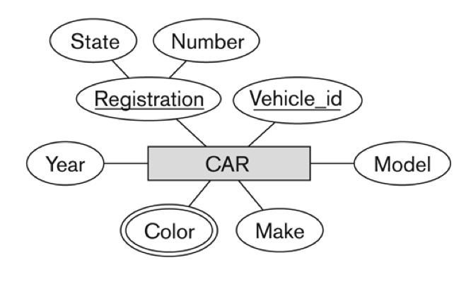
Key Attribute
An entity set can have several key attributes
A key attribute may be composite.
Name
SIN#
E#
Employee

Slide 23
Weak Entity Set
An entity set that does not have a key attribute
Depicted using double rectangle
Its entity cannot exist independently in the database
Its existence depends on the existence of an independent (strong) entity called owner entity.
it must be related to the owner entity set via a total, one-to-many identifying relationship set from the owner entity set to the weak entity set
E#
Name
Name
1
has
M
Employee
Dependent
Owner Entity Set
Weak Entity Set
Identifying Relationship Set
Notes:
Identifying relationship depicted using a double diamond

Slide 24
Weak Entity Sets
The partial key of a weak entity set is the attributes that uniquely identify a weak entity for a given owner entity.
Partial key attributes are marked with dotted underline
The key of a weak entity set is formed by the key of the owner entity set on which the weak entity set is existence dependent, plus the weak entity set’s partial key.
The key of Dependent: (E#, Dname)
E#
Name
Dname
1
has
M
Employee
Dependent
Owner Entity Set
Weak Entity Set
Identifying Relationship Set

Slide 25
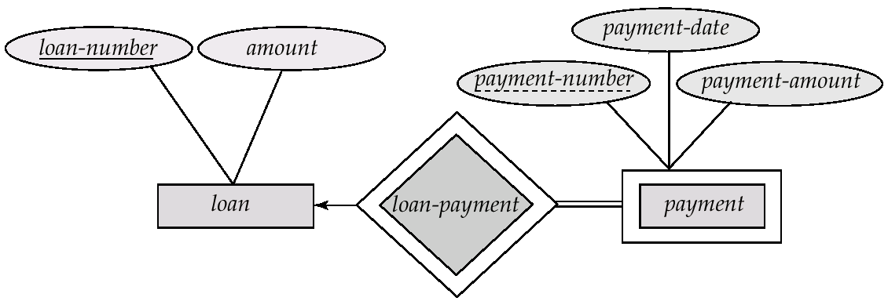
Weak Entity Sets
payment-number – partial key of the payment entity set
key for payment – (loan-number, payment-number)

Slide 26
Weak Entity Sets
More Examples
name
address
number
address
1
Has
M
Bank
Branch
name
name
number
1
PlaysOn
M
Teams
Players

Slide 27
Self Relationship
Entities in a entity set may relate to other entities in the same set.
Here employees manage some other employees
The labels “manager” and “worker” are called roles of the self relationship
Supervise
Employee
manager
worker
Employee
Supervise
In ER diagram, an entity set cannot appear more than once, so it should be represented as:
supervisor
supervisee
Employee

Slide 28
Self (Recursive) Relationship
More Examples
Married
PC
husband
wife
Parent
Child
Person
Person

Slide 29
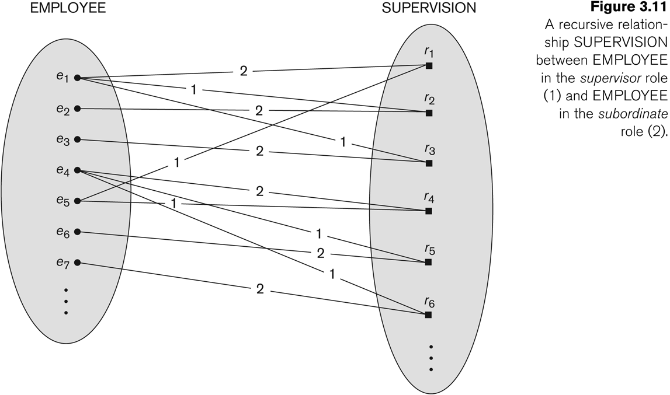
Self Relationship: SUPERVISION

Slide 30
Recursive Relationship: SUPERVISION
Figure 3.2 An ER schema diagram for the COMPANY database.

Slide 31
Cardinality Constraints: Method 1
Cardinality ratio (of a binary relationship):
1:1,
1:N,
N:1,
N:N
Shown by placing appropriate numbers on the relationship edges.
Participation constraint (on each participating entity set): total (called existence dependency) or partial.
Total shown by double line, partial by single line.

Slide 32
Cardinality Constraints: Method 1
One-to-One
One-to-Many and Many-to-One
Many-to-Many
Employee
1
Manages
1
Department
Employee
N
WorksFor
1
Department
Student
N
Takes
N
Course

Slide 33
Cardinality Constraints
1:1
1:N
N:1
N:N
Instance Level Examples

Slide 34
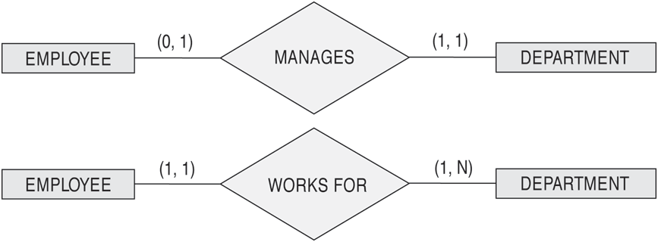
Cardinality Constraints: Method 2
Using (min, max) to specify the participation of an entity set in a relationship set with min≤max, min≥0, max ≥1
Employee
1
Manages
1
Department
Employee
N
WorksFor
1
Department
Notes:
Default(no constraint): min=0, max=n (signifying no limit)

Slide 35
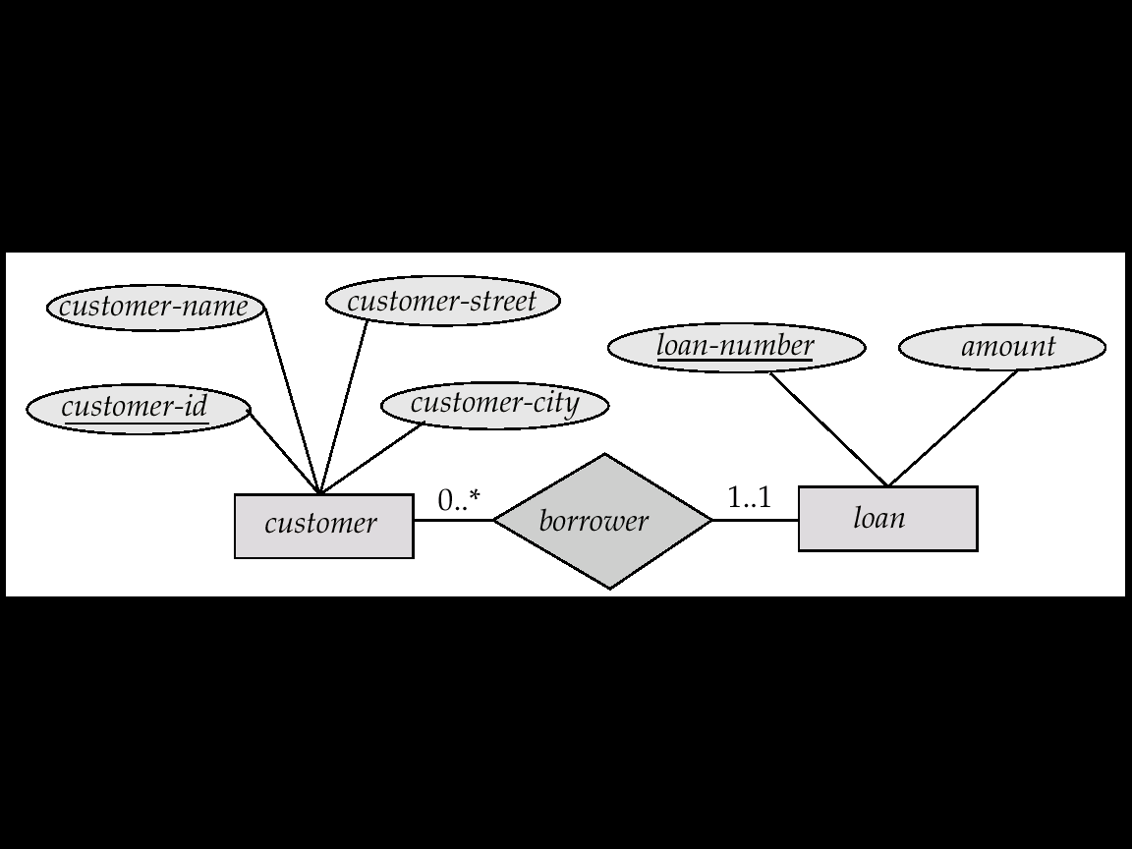
Cardinality Constraints: Method 2

Slide 36
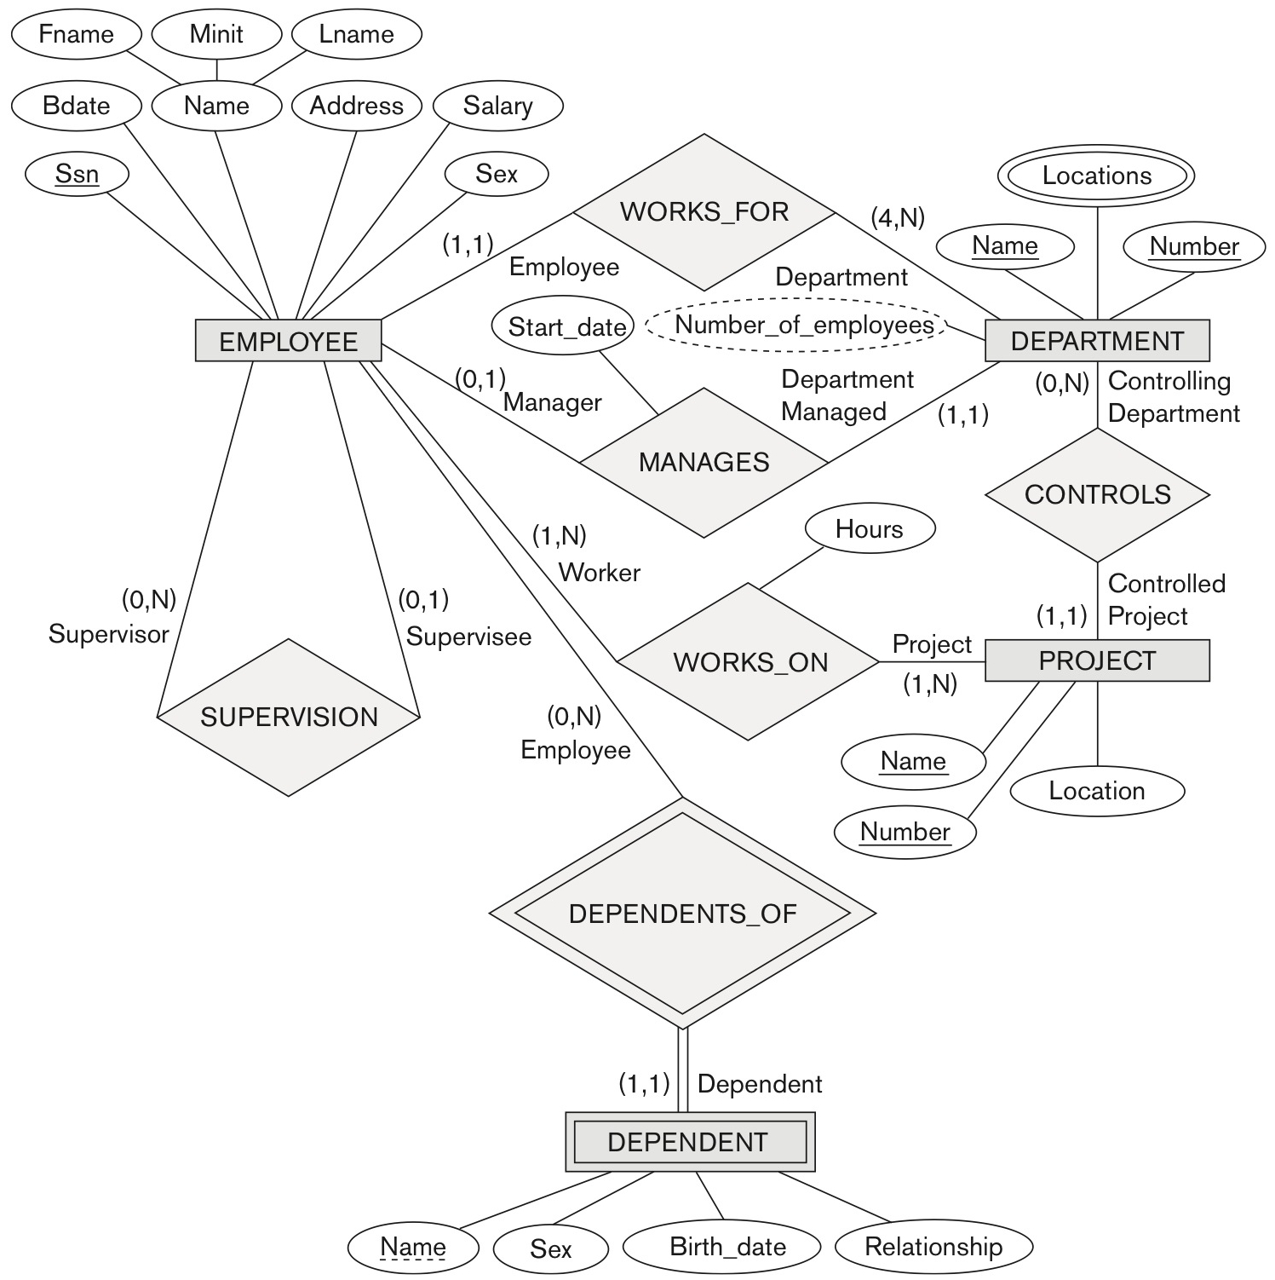
Cardinality Constraints: Method 2
Figure 3.15 ER diagrams for the company schema, with structural constraints specified using (min, max) notation and role names.

Slide 37
Cardinality Constraints: Method 3
One to One
Partial
Total
Employee
Manages
Department
One
One

Slide 38
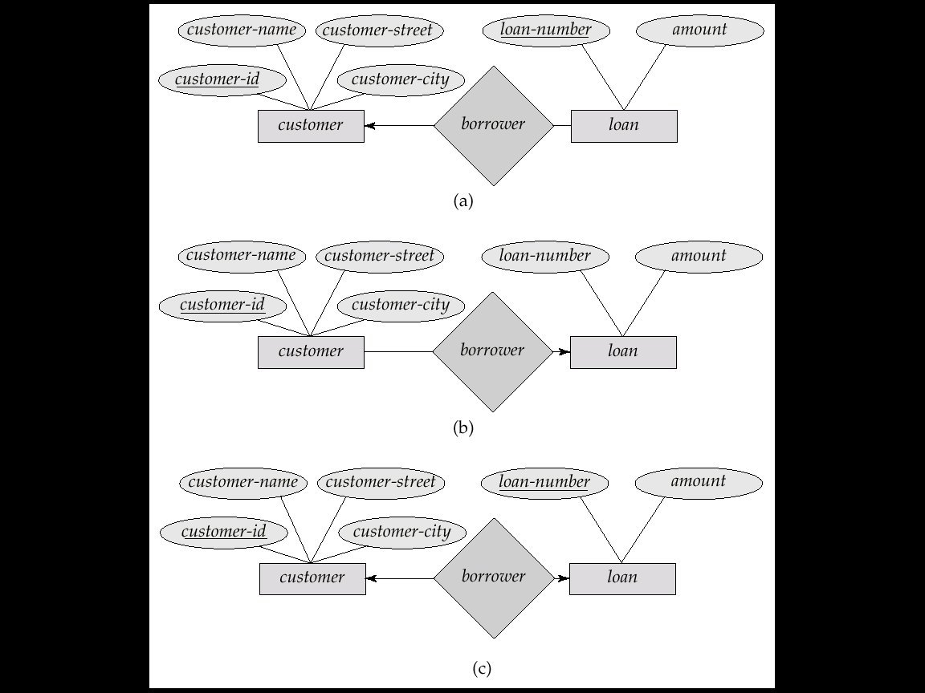
Cardinality Constraints: Method 3
One to Many
One
Many

Slide 39

Cardinality Constraints: Method 3
Many to One
Many
One

Slide 40
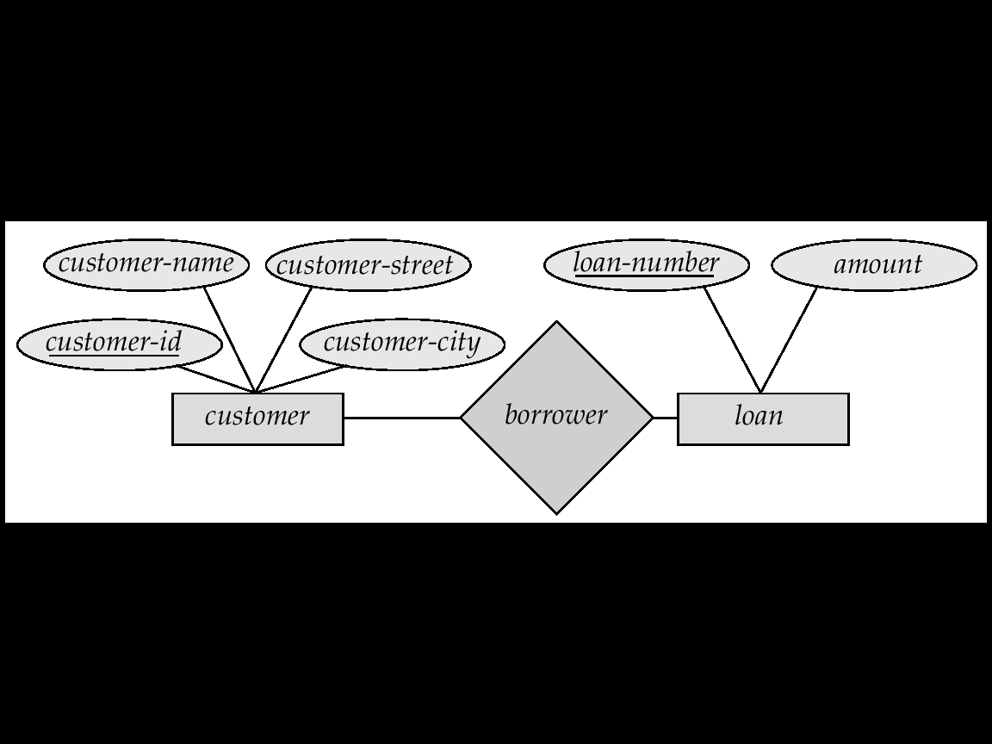
Cardinality Constraints: Method 3
Many to Many
Many
Many

Slide 41
Degree of a Relationship Set
The number of entity sets that participate in a relationship set.
Relationship sets that involve two entity sets are binary (or degree two). Generally, most relationship sets in a database system are binary.
Relationship sets may involve more than two entity sets.

Slide 42
Relationships of Higher Degree
Relationship sets of degree 2 are called binary
Relationship sets of degree 3 are called ternary and of degree n are called n-ary
In general, an n-ary relationship is not equivalent to n binary relationships
Constraints are harder to specify for higher-degree relationships (n > 2) than for binary relationships

Slide 43
Ternary Relationship
C#
Name
Course
E#
Name
S#
Name
Offer
Instructor
Student
Grade

Slide 44
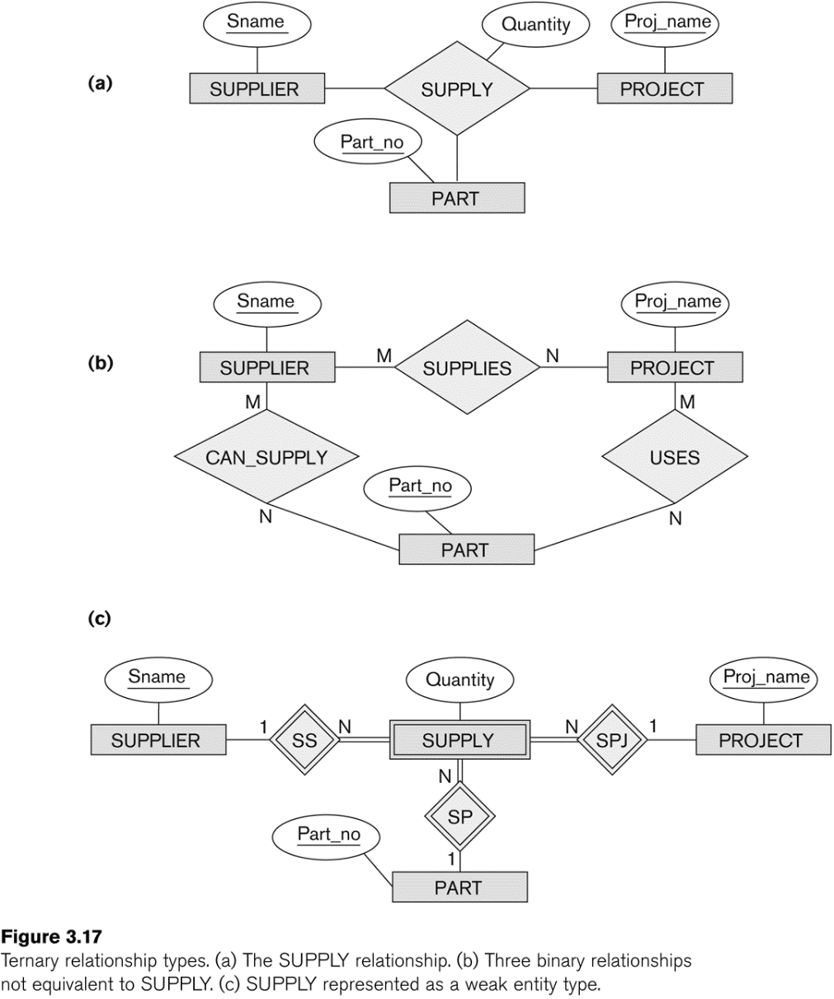
Example of a ternary relationship
Notes:
Can represent relationship attribute
Use three binary relationship to represent but cannot represent the relationship attribute
Introducing a new weak entity set to represent relationship attribute, extra entity set (see later slides)

Slide 45
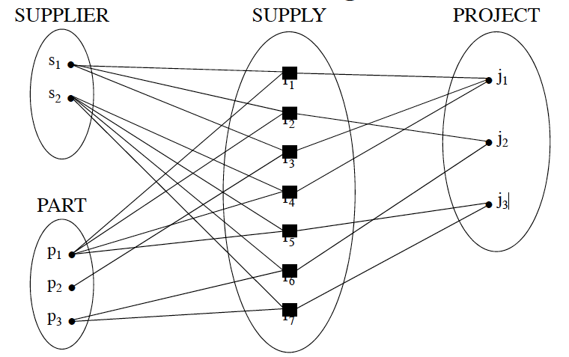
Ternary Relationship Instance Diagram

Slide 46
Discussion of n-ary relationships (n > 2)
In general, 3 binary relationships can represent different information than a single ternary relationship (see Figure 3.17a and b)
If needed, the binary and n-ary relationships can all be included in the schema design (see Figure 3.17a and b, where all relationships convey different meanings)
In some cases, a ternary relationship can be represented as a weak entity if the data model allows a weak entity set to have multiple identifying relationships (and hence multiple owner entity sets) (see Figure 3.17c)
If a particular binary relationship can be derived from a higher-degree relationship at all times, then it is redundant (see Figure 3.18)

Slide 47
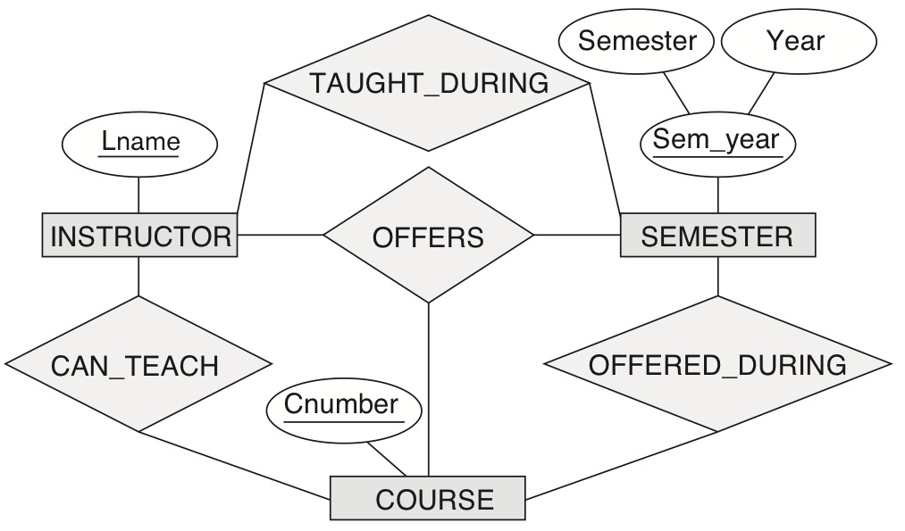
Another example of a ternary relationship
Figure 3.18 Another example of ternary versus binary relationship types.

Slide 48
Can We Decompose a Ternary Relationship?
Some relationships that appear to be non-binary may be better represented using binary relationships
Example.
A ternary relationship parents, relating a child to his/her father and mother,
It is best replaced by two binary relationships, father and mother. Using two binary relationships allows partial information (e.g. only mother being know)
Person
Parents
Person
Father
Person
Mather

Slide 49
Can We Decompose a Ternary Relationship?
But there are some relationships that are naturally non-binary
Example
Grade
N
Offering
N
Course
Instructor
N
Student

Slide 50
Can We Decompose a Ternary Relationship?
But there are some relationships that are naturally non-binary
Example
Grade
(1,2)
Offering
(1,3)
Course
Instructor
(1,5)
Student
A Teacher can offer min 1 and max 2 Offerings
A Course may have 1 to 3 Offerings
A Student may enroll in from 1 to 5 Offerings

Slide 51
Aggregation
Aggregation allows us to treat a relationship set as an entity set for purposes of participation in (other) relationships.
name
Employees are assigned to monitor SPONSORSHIPS.
ssn
lot
Employees
Monitors
until
started_on
since
dname
pid
pbudget
did
budget
Projects
Sponsors
Departments

Slide 52
Aggregation vs. ternary relationship
Monitors and Sponsors are distinct relationships, with descriptive attributes of their own.
Also, can say that each sponsorship is monitored by at most one employee (which we cannot do with a ternary relationship).
name
ssn
lot
Employees
Monitors
until
started_on
since
dname
pid
pbudget
did
budget
Projects
Sponsors
Departments

Slide 53
ER Model
Entity Types
Regular Entity Sets
Weak Entity Sets
Relationship Types
Regular Relationship Sets
Weak Relationship Sets
Attributes
Single Valued
Multivalued
Composite

Slide 54
ER Model Constraints
Relationship Constraints
Degree
recursive (unary)
binary
n-ary
Cardinality
one to one (1:1)
one to many (1:m)
many to one (m:1)
many to many (m:n)
Participation
total/mandatory
Partial/optional
Attribute Constraints
Key
Partial Key
S#
Name

Slide 55
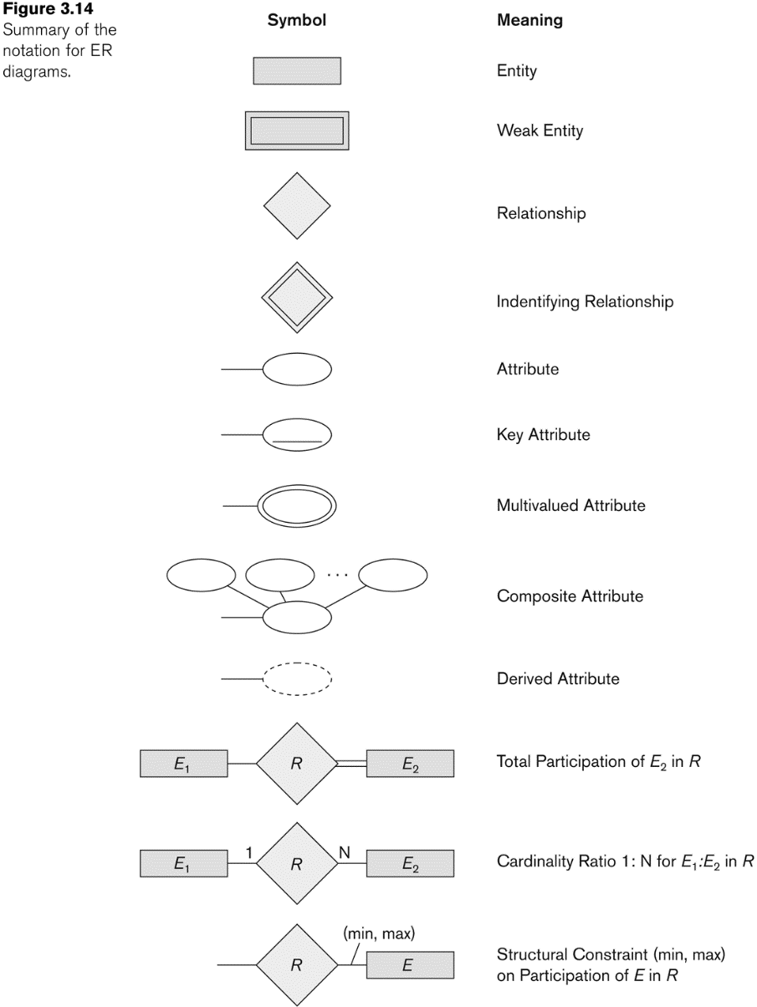
NOTATION for ER diagrams

Slide 56
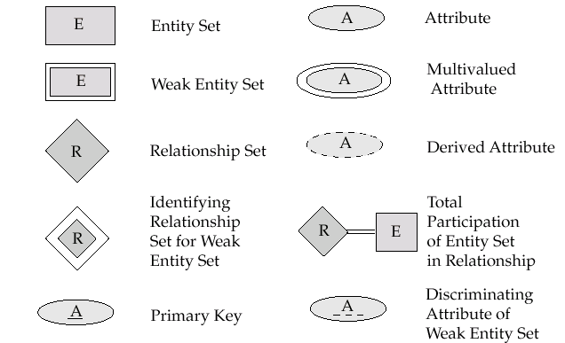
NOTATION for ER diagrams
Partial Key for
Key

Slide 57

NOTATION for ER diagrams

